Slide 1
CSCI 4110 Modeling The Basics
Mark Green
Faculty of Science
UOIT

Slide 2
Introduction
Representing geometrical information about objects
Mainly shape, but could be interested in other physical properties
Used in rendering, but also in animation
Not just computer graphics, computer aided design, simulation, engineering, etc.
Other disciplines have different representations, but there are some common ones

Slide 3
Introduction
Where does this information come from:
Modeling programs
Design programs
Scientific/engineering simulations
Programs, computational models
Digitization of real objects

Slide 4
Introduction
Interested in representing geometry of 3D objects, two main types of representations:
Volume
Surface
Volume representations capture the volume occupied by the object, the solid properties of the object
Useful in some computer animation algorithms and rendering algorithms
Common in other disciplines

Slide 5
Introduction
Surface representations are the most common in computer graphics, this is what we draw
We will be mainly interested in surface representations
There are three main types of surface operations:
Evaluation
Query
Modification

Slide 6
Introduction
Evaluation operations produce points on the surface, sampling the surface of the object
This is important for rendering, usually the first operation we think of
Query operations determine information about a surface or solid, for example if a point is inside, outside or on the surface of an object
The distance from a point to an object, collisions
Useful in some animation algorithms

Slide 7
Introduction
Modification operations are used to change the shape of an object
Important in the design and construction of objects
The ability to interactively edit or modify the shape of an object
Used in animation for objects that change shape during the animation
Some of the most difficult and challenging operations

Slide 8
Surfaces
Definition:
An orientable continuous 2D manifold embedded in R³
What does this mean?
Basically the surface of a non-degenerate solid, one that has no infinitely thin parts and is not divided into separate pieces
For parameterized surfaces, the parameter space is continuous, and all points within a sufficiently small sphere on the surface are generated by a similar small surface in parameter space

Slide 9
Surfaces
Why is this important?
We can construct non-manifold representations, some of our data structures allow this
Problem: some algorithms cannot deal with these surfaces
Algorithms that need to visit the locality of a particular point can break down, since locality may not be well defined
Usually not a problem for display, but can be a problem for query and manipulation

Slide 10
Surfaces
Two main types of surface representations:
Parametric
Implicit
The surface of a 3D object is really 2D, so we can define a 2D coordinate space on the surface, the parameter space: (u, v)
Points on the surface given by:
x = X(u, v)
y = Y(u, v)
z = Z(u, v)

Slide 11
Surfaces
By sweeping out all the points in (u, v) space we can generate all the points on the surface
While the parameter space can be all of R², we usually restrict it to a small finite range:
0 ≤ u, v < 1
Typically all of our surface will be parameterized in this way for consistency
Most parameterized representations are a good approximation to a small part of a surface, but not to the complete surface

Slide 12
Surfaces
Piecewise representation: individual parameterized surface pieces are stitched together to form larger surfaces
With enough pieces we can cover the complete surface
We can have a parameter space for the entire surface, and then a mapping to the local parameter spaces for each of the pieces
Can use simple primitives to build up complex surfaces, algorithms work on the pieces, so they can be simpler

Slide 13
Surfaces
At first implicit representations look simpler, in these representations a point on the surface (x, y, z) satisfies the following equation:
f(x , y, z) = 0
If f(x, y, z) < 0, the point is inside the object and if f(x, y, z) > 0 the point is outside of the object
Most implicit representations are not piecewise, but this is possible
Implicit representations are very good for queries, an inside test is easy, and in some cases distance tests are also quite easy

Slide 14
Surfaces
Implicit representations are quite often constructed from volumetric data, usually in the form of isosurfaces, the collection of points in the volume that have same value
Implicit surfaces can be notoriously difficult to display, since there is no way to explicitly enumerate the points on the surface
They are usually converted to a parametric representation for display

Slide 15
Surfaces
Implicit and parametric representations are complementary in the sense that where one representation is strong the other is weak
There are algorithms for converting between implicit and parametric representations for this reason
In many cases these conversions are not exact and some care must be used to avoid excessive deterioration

Slide 16
Example
Spheres have both implicit and a parametric representations, so they are a good example
The implicit representation for a sphere is:
x² + y² + z² –R² = 0
This is for a sphere of radius R centered at the origin
The parametric representation for the same sphere is:
x = RcosФsinθ
y = RsinФsinθ
z = Rcosθ

Slide 17
Polygons
We can have both implicit and parametric representations for polygons, but typically they aren’t stored that way
A polygon is a subset of the plane with its boundary defined by a finite set of edges, each edge is a line segment defined by two vertices
Each polygon has a plane equation, which can be computed from its vertices
Note: in practice only triangles are guaranteed to be planar

Slide 18
Polygons
The simplest data structure is to store each polygon as a list of its vertices, usually this list is stored in counter-clockwise direction
Each polygon can be viewed as an array of vertices, with possibly a plane equation and material information
This is sometimes called polygon soup, since there is no structure to the representation
Assuming that floats are used for coordinates, each vertex requires 12 bytes, so each polygon requires 12n bytes, where n is the number of vertices

Slide 19
Polygons
Note: the surface doesn’t need to be continuous or manifold, it can store any collection of polygons
For what it does polygon soup is expensive, vertices can be stored many times, which is a waste of space
There is no connectivity information
A better data structure is an indexed face set, which is based on two tables, one for vertices and one for faces (polygons)

Slide 20
Polygons
Vertex table has one entry per vertex, stores the vertex coordinates
Could also store normal and material information
Each vertex is stored only once
The face table contains pointers or indices into the vertex table and not the vertex coordinates themselves
Even with 32 bit integers or pointers this is a 50% space savings
Can also determine basic connectivity information, but not efficiently

Slide 21
Polygons
Indexed face sets can represent the same objects as polygon soup, can easily convert polygon soup to this representation
Loop through the polygons storing the vertices in the vertex table (make sure they are unique) and store indices in face table
Use a hash function for the vertex table to produce a close to linear algorithm
This is the most common data structure in computer graphics, used in many file formats and OpenGL

Slide 22
Polygons
Previous two data structures are good for display, but not very good for processing polygons
Can represent non-manifold surfaces and hard to determine connectivity information
Edge based data structures solve these problems
Polygon viewed as a list of edges, each edge has two vertices and belongs to two faces
These data structures are based on three tables, vertex, edge and face

Slide 23
Polygons
The winged edge data structure is based on storing the following information for each edge:
Its two vertices
Its two faces
The next edge for each face
The previous edge for each face
Each vertex stores its position and a pointer to one of its edges
Each face stores a pointer to one of its edges

Slide 24
Winged Edge

Slide 25
Winged Edge
struct Edge {
VertexRef vertex[2];
FaceRef face[2];
EdgeRef next[2];
EdgeRef prev[2];
};
struct Vertex {
Point position;
EdgeRef edge;
};
struct Face {
EdgeRef edge;
};

Slide 26
Polygons
To draw a face follow its edge reference to the first edge in the face and then follow the next pointers to traverse all the edges
At each edge collect the next vertex in the polygon
Similarly we can find all the polygons that share a vertex by first following the edge pointer and then following the face pointers in a loop around the vertex
Neighbourhood and connectivity information can be determined very quickly, just need to follow pointers

Slide 27
Polygons
One of the problems with the winged edge data structure is knowing which of the two next pointers to follow, there are two for each edge, which entry belongs to which face?
This can be solved by using a half edge data structure
Each edge is split into two directed half edges, each stores half the information of an edge
Now the face that the edge belongs to is uniquely identified

Slide 28
Half Edge

Slide 29
Half Edge
struct HalfEdge {
VertexRef vertex;
FaceRef face;
HalfEdgeRef next;
HalfEdgeRef prev;
HalfEdgeRef opposite;
};
struct Vertex {
Point position;
HalfEdgeRef halfedge;
}:
struct Face {
HalfEdgeRef halfedge;
}

Slide 30
Polygons
The edge data structures support efficient algorithms for connectivity and neighbours
They don’t allow us to create non-manifold surfaces
But they require significantly more storage space, a classical space/time trade-off
These data structures are popular in CAD programs and programs that perform sophisticated processing of polygonal meshes, they are typically not required for rendering and animation algorithms

Slide 31
Polygons
It is possible to convert a indexed face set into an edge data structure
Traverse the vertices around the polygon, construct an edge for each pair
For each vertex record the newly constructed edge
When we encounter the same vertex pair again construct the other half of the edge
If we encounter the same edge more than twice we have a non-manifold surface, which is an error

Slide 32
Triangles
We love triangles:
The simplest polygon
Always planar
Graphics hardware optimized for triangles
Can convert other polygons to triangles, for convex polygons simple linear algorithm
We really only need triangles, used as internal representation in many graphics packages
Can simplify and optimize the data structures

Slide 33
Triangles
Non-planar polygons, our data structures don’t force polygons to be planar
Planar polygons are required by many algorithms, including display
How do we get non-planar polygons:
Bad data
Incorrect algorithms
Text file formats that truncate coordinate values
Rounding error
There are ways to detect and fix this problem

Slide 34
Triangles
Plane equation:
Ax + By + Cz + d = 0
Normalize (A, B, C) to get the polygon normal
Substituting a vertex into the plane equation tells us if its on the plane, if not, move it in normal direction until it lies on the plane
Store plane equation with the polygon, or compute it each time the polygon is read from a file
This simple check will solve a lot of problems

Slide 35
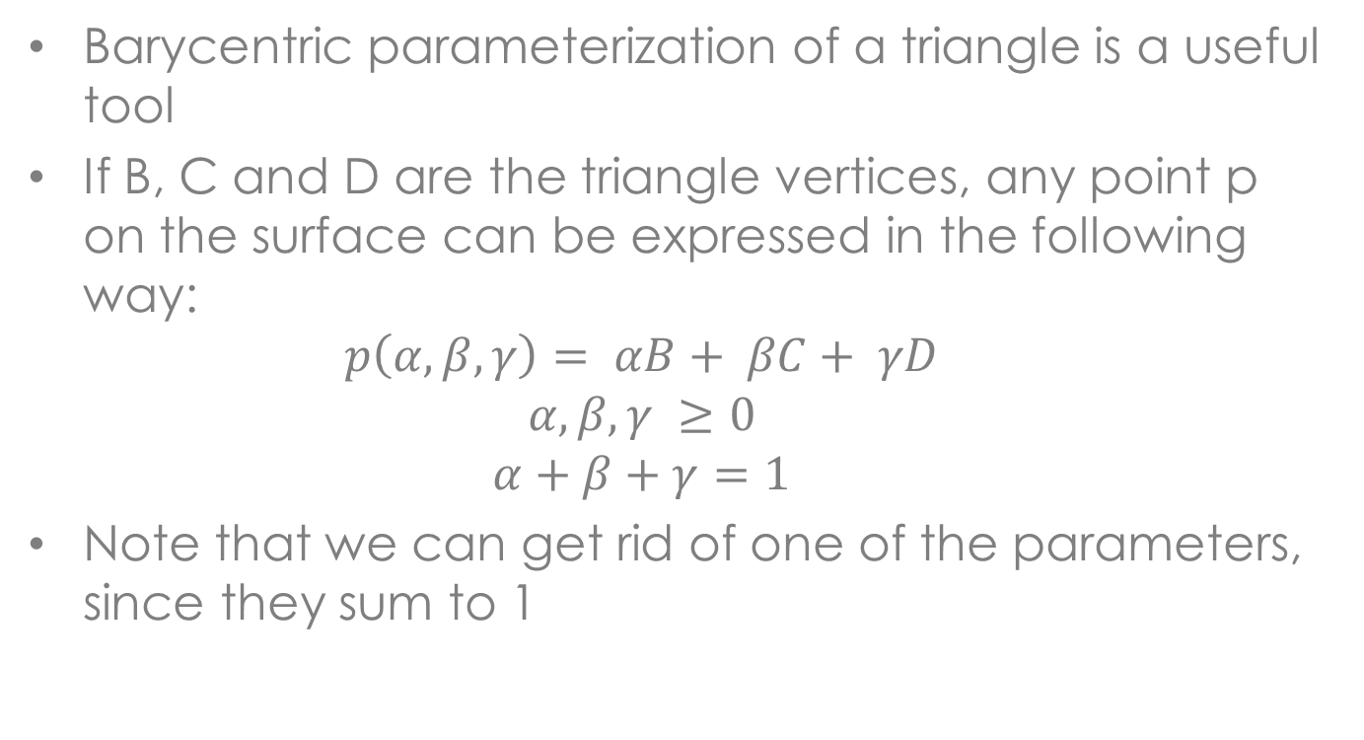
Triangles
Barycentric parameterization of a triangle is a useful tool
If B, C and D are the triangle vertices, any point p on the surface can be expressed in the following way:
$$p\left(α,β,γ\right)= αB+ βC+ γD$$
$$α, β, γ ≥0$$
$$α+β+γ=1$$
Note that we can get rid of one of the parameters, since they sum to 1

Slide 36
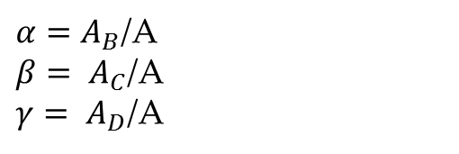

Triangles
C
$$(α, β, γ)$$
A_{D}
$α=A_{B}$/A
$β= A_{C}$/A
$γ= A_{D}$/A
A_{B}
A_{C}
B
D

Slide 37
Software
Polygon soup and indexed face sets are relatively easy to implement correctly
The edge based data structures are more difficult to implement, you should use existing software packages:
Openmesh – www.openmesh.org
Meshlab – meshlab.sourceforge.net
CGAL (Computational Geometry Algorithms Library) – www.cgal.org
Note that CGAL is a complicated library that requires some effort to build, but it includes lots of cool things

Slide 38
Resources
Botsch M., L. Kobbelt, M. Pauly, P. Alliez, B. Levy, Polygon Mesh Processing, AK Peters, 2010

Slide 39
Differential Geometry
Many real world objects are not made out of polygons, they have continuously varying shapes
There are modeling techniques for curved surfaces, we will look at them later, but they must eventually be converted into polygons for display
We need to understand the geometry of these surfaces to properly convert them into polygons and compute some of their surface properties
Differential geometry provides the vocabulary and techniques that we need

Slide 40
Differential Geometry
Start by examining 2D curves, since the are simpler
A 2D curve has a single parameter u, and can be written as f(u), where f(u) can be decomposed into x(u) and y(u) that give the points along the surface
The tangent to the curve is the first derivative of f with respect to u, f’(u) = (x’(u), y’(u))
This is a vector in the direction the curve is moving, if we rotate this vector by 90 degrees we get the normal to the curve

Slide 41
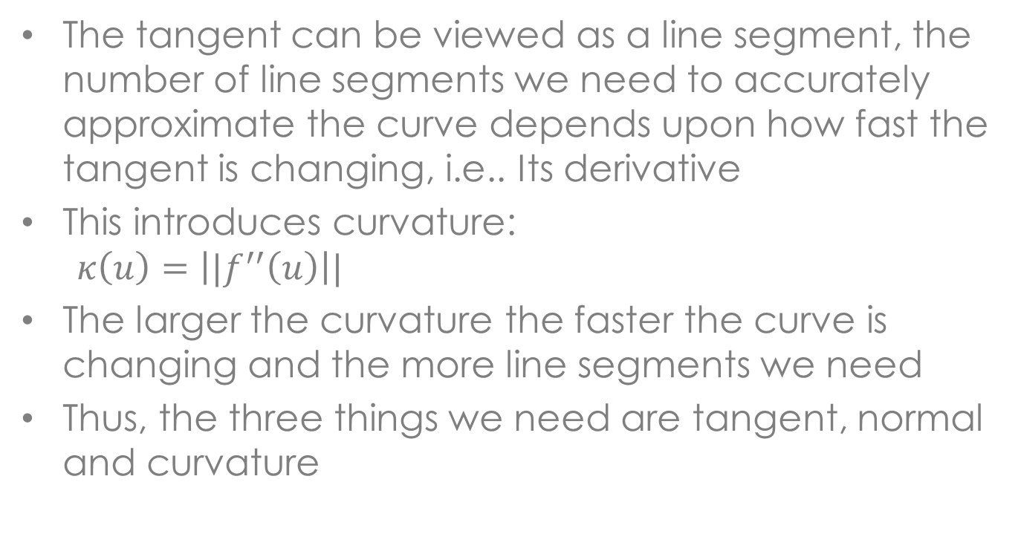
Differential Geometry
The tangent can be viewed as a line segment, the number of line segments we need to accurately approximate the curve depends upon how fast the tangent is changing, i.e.. Its derivative
This introduces curvature:
$$κ\left(u\right)=\left||f^{′′}\left(u\right)\right||$$
The larger the curvature the faster the curve is changing and the more line segments we need
Thus, the three things we need are tangent, normal and curvature

Slide 42
Differential Geometry
With surfaces things become more complicated
We now have two parameters u, v and the surface points are given by:
f(u,v) = ( x(u,v), y(u,v), z(u,v) )
We can still get a tangent vector by differentiation, but there are now two obvious choices:
f_{u}(u,v)
f_{v}((u,v)
These two vectors define a tangent plane, all the tangent vectors lie in this plane

Slide 43
Differential Geometry
The normal vector is now relatively easy to compute:
N = (f_{u} x f_{v}) /||f_{u} x f_{v} ||
The problem comes with curvature, where there are multiple definitions
We could use f_{uu} and f_{vv} but they are not necessarily the maximum curvatures
There is a unique maximum and minimum curvature and there are tangent vectors associated with them, they are relatively easy to compute

Slide 44
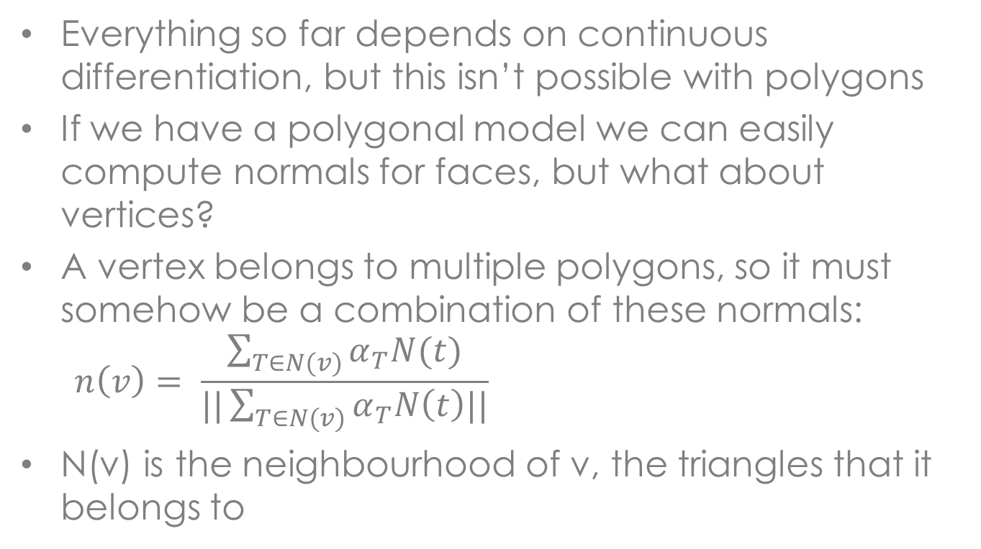
Differential Geometry
Everything so far depends on continuous differentiation, but this isn’t possible with polygons
If we have a polygonal model we can easily compute normals for faces, but what about vertices?
A vertex belongs to multiple polygons, so it must somehow be a combination of these normals:
$$n\left(v\right)= \frac{\sum_{T∈N(v)}{α_{T}N(t)}}{||\sum_{T∈N(v)}{α_{T}N\left(t\right)||}}$$
N(v) is the neighbourhood of v, the triangles that it belongs to

Slide 45
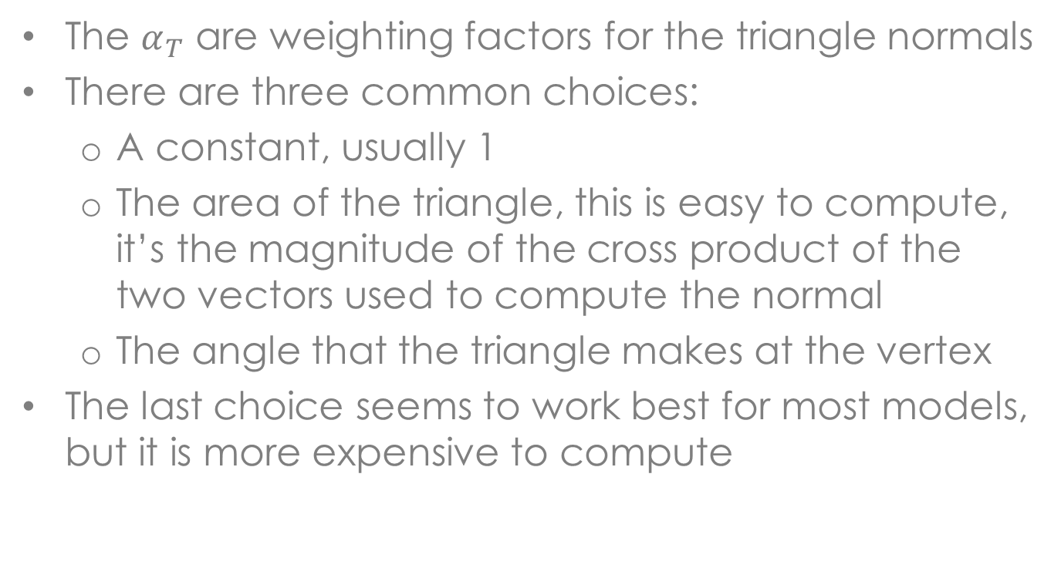
Differential Geometry
The $α_{T}$ are weighting factors for the triangle normals
There are three common choices:
A constant, usually 1
The area of the triangle, this is easy to compute, it’s the magnitude of the cross product of the two vectors used to compute the normal
The angle that the triangle makes at the vertex
The last choice seems to work best for most models, but it is more expensive to compute

Slide 46
Summary
Introduction to the operations we might want to perform on a model
The different types of models: implicit and parametric
Scheme for representing polygonal models
Some basic differential geometry for curves and surfaces

